Slide 1
MPI PROGRAMMING compiled by Dr. N. Gopalakrishna Kini Prof., Dept of CSE MIT, Manipal

Slide 2
What is MPI?
Processes coordinate and communicate via calls to message passing library routines.
Programmers “parallelize” algorithm and add message calls.
MPI addresses primarily the message-passing parallel programming model.

Slide 3
Key Concepts of MPI
Used to create parallel programs
Normally the same program is running.
Processors communicate using message passing.
No process can be created or terminated in the middle of program execution.

Slide 4
Introduction:
autonomous processes.
MIMD style.
processes communicate via calls to MPI communication primitives.
The major goal of MPI, as with most standards, is a degree of portability across different machines.
Another type of compatibility offered by MPI is the ability to run transparently on heterogeneous systems.
MPI allows or supports scalability.

Slide 5
MPI Program Organization
MIMD Multiple Instruction, Multiple Data
SPMD Single Program, Multiple Data

Slide 6
MPI Progam Organization
MIMD in a SPMD framework

Slide 7
The message-passing programming model →each processor has a local memory to which it has exclusive access.
The number of processes is fixed when starting the program.
Each of the processes could execute a different program (MPMD).

Slide 8
Message Passing Work Allocation
Manager Process
Worker Process

Slide 9
Message-passing program can exchange local data by using communication operations.
MPI consists of a collection of processes.
Processes in MPI are heavy-weighted and single threaded with separate address spaces.
On many parallel systems, an MPI program can be started from the command line.

Slide 10
General MPI Program Structure
MPI include file
variable declarations
#include <mpi.h>
void main (int argc, char *argv[])
{
int np, rank, ierr;
ierr = MPI_Init(&argc, &argv);
MPI_Comm_rank(MPI_COMM_WORLD,&rank);
MPI_Comm_size(MPI_COMM_WORLD,&np);
/* Do Some Works */
ierr = MPI_Finalize();
}
#include <mpi.h>
void main (int argc, char *argv[])
{
int np, rank, ierr;
ierr = MPI_Init(&argc, &argv);
MPI_Comm_rank(MPI_COMM_WORLD,&rank);
MPI_Comm_size(MPI_COMM_WORLD,&np);
/* Do Some Works */
ierr = MPI_Finalize();
}
#include <mpi.h>
void main (int argc, char *argv[])
{
int np, rank, ierr;
ierr = MPI_Init(&argc, &argv);
MPI_Comm_rank(MPI_COMM_WORLD,&rank);
MPI_Comm_size(MPI_COMM_WORLD,&np);
/* Do Some Works */
ierr = MPI_Finalize();
}
#include <mpi.h>
void main (int argc, char *argv[])
{
int np, rank, ierr;
ierr = MPI_Init(&argc, &argv);
MPI_Comm_rank(MPI_COMM_WORLD,&rank);
MPI_Comm_size(MPI_COMM_WORLD,&np);
/* Do Some Works */
ierr = MPI_Finalize();
}
#include <mpi.h>
void main (int argc, char *argv[])
{
int np, rank, ierr;
ierr = MPI_Init(&argc, &argv);
MPI_Comm_rank(MPI_COMM_WORLD,&rank);
MPI_Comm_size(MPI_COMM_WORLD,&np);
/* Do Some Works */
ierr = MPI_Finalize();
}
Initialize MPI environment
Do work and make
message passing calls
Terminate MPI Environment

Slide 11
MPI Naming Conventions
The names of all MPI entities (routines, constants, types, etc.) begin with MPI_ to avoid conflicts.
C function names have a mixed case:
MPI_Xxxxx(parameter, ... )
Example: MPI_Init(&argc, &argv).
The names of MPI constants are all upper case in both C and Fortran, for example,
MPI_COMM_WORLD, MPI_REAL, ...
In C, specially defined types correspond to many MPI entities. Type names follow the C function naming convention above; for example,
MPI_Comm
is the type corresponding to an MPI "communicator".

Slide 12
MPI Routines and Return Values
MPI routines are implemented as functions in C. In either case generally an error code is returned, enabling you to test for the successful operation of the routine.
In C, MPI functions return an int, which indicates the exit status of the call.
int ierr;
...
ierr = MPI_Init(&argc, &argv);
...

Slide 13
MPI Routines and Return Values
The error code returned is MPI_SUCCESS if the routine ran successfully (that is, the integer returned is equal to the pre-defined integer constant MPI_SUCCESS). Thus, you can test for successful operation with
If an error occurred, then the integer returned has an implementation-dependent value indicating the specific error.

Slide 14
int rank;
MPI_Init((void *), (void *));
MPI_Comm_rank(MPI_COMM_WORLD, &rank);
if (rank == 0)
printf("Starting program\n");
MPI_Finalize();

Slide 15
Special MPI Datatypes (C)
In C, MPI provides several special datatypes (structures). Examples include
MPI_Comm - a communicator
MPI_Status - a structure containing several pieces of status information for MPI calls
MPI_Datatype
These are used in variable declarations, for example,
MPI_Comm some_comm;
declares a variable called some_comm, which is of type MPI_Comm (i.e. a communicator).

Slide 16
Include files
The MPI include file
C: mpi.h

Slide 17
Initializing MPI
The first MPI routine called in any MPI program must be the initialization routine MPI_Init. This routine establishes the MPI environment, returning an error code if there is a problem.
Note that the arguments to MPI_Init are the addresses of argc and argv.

Slide 18
Communicators
A communicator is a handle representing a group of processors that can communicate with one another.
The communicator name is required as an argument.

Slide 19
Communicators
There can be many communicators, and a given processor can be a member of a number of different communicators.

Slide 20
Getting Communicator Information: Rank
A processor can determine its rank in a communicator with a call to MPI_Comm_rank.
The argument comm is a variable of type MPI_Comm, a communicator.
Note that the second argument is the address of the integer variable rank.

Slide 21
Getting Communicator Information: Size
A Communicator can also determine the size, or number of processors, of any communicator to which it belongs with a call to MPI_Comm_size.
The argument comm is of type MPI_Comm, a communicator.
Note that the second argument is the address of the integer variable size.

Slide 22
Terminating MPI
The last MPI routine called should be MPI_Finalize which
cleans up all MPI data structures, cancels operations that never completed, etc.
must be called by all processes; if any one process does not reach this statement, the program will appear to hang.
Once MPI_Finalize has been called, no other MPI routines (including MPI_Init) may be called.

Slide 23
Sample Program: Hello World!
In this "Hello World" program, each processor prints its rank as well as the total number of processors in the communicator MPI_COMM_WORLD.
Notes:
Makes use of the pre-defined communicator MPI_COMM_WORLD.
Not testing for error status of routines!

Slide 24
Sample Program: Hello World!
#include <stdio.h>
#include <mpi.h>
void main (int argc, char *argv[]) {
int myrank, size;
/* Initialize MPI */
MPI_Init(&argc, &argv);
/* Get my rank */
MPI_Comm_rank(MPI_COMM_WORLD, &myrank);
/* Get the total number of processors */
MPI_Comm_size(MPI_COMM_WORLD, &size);
printf("Processor %d of %d: Hello World!\n", myrank, size);
MPI_Finalize(); /* Terminate MPI */
}

Slide 25
Sample Program: Output
Running this code on four processors will produce a result like:
Processor 2 of 4: Hello World!
Processor 1 of 4: Hello World!
Processor 3 of 4: Hello World!
Processor 0 of 4: Hello World!
Each processor executes the same code, including probing for its rank and size and printing the string.

Slide 26
Summary
MPI is used to create parallel programs based on message passing
Usually the same program is run on multiple processors
The 6 basic calls in MPI are:
MPI_INIT( ierr )
MPI_COMM_RANK( MPI_COMM_WORLD, myid, ierr )
MPI_COMM_SIZE( MPI_COMM_WORLD, numprocs, ierr )
MPI_Send(buffer, count,MPI_INTEGER,destination, tag, MPI_COMM_WORLD, ierr)
MPI_Recv(buffer, count, MPI_INTEGER,source,tag, MPI_COMM_WORLD, status,ierr)
call MPI_FINALIZE(ierr)

Slide 27
Point-to-Point Communication
A communicator → communication domain → a set of processes that exchange messages between each other.
MPI default communicator MPI_COMM_WORLD is used.
Basic form of data exchange between processes is provided by point-to-point communication.

Slide 28
int MPI_Send(void *smessage,
int count,
MPI_Datatype datatype,
int dest,
int tag,
MPI_Comm comm)

Slide 29
To receive a message, a process executes the following operation:
int MPI_Recv(void *rmessage,
int count,
MPI_Datatype datatype,
int source,
int tag,
MPI_Comm comm,
MPI_Status *status)

Slide 30
Predefined data types for MPI
MPI_Datatype C-Data type
MPI_CHAR signed char
MPI_SHORT signed short int
MPI_INT signed int
MPI_LONG signed long int
MPI_LONG_LONG_INT long long int
MPI_UNSIGNED_CHAR unsigned char
MPI_UNSIGNED_SHORT unsigned short int
MPI_UNSIGNED unsigned int
MPI_UNSIGNED_LONG unsigned long int
MPI_UNSIGNED_LONG_LONG unsigned long long int
MPI_FLOAT float
MPI_DOUBLE double
MPI_LONG_DOUBLE long double
MPI_WCHAR wide char
MPI_PACKED special data type for packing
MPI_BYTE single byte value

Slide 31
Some semantic terms that are used for the description of MPI operations:
Blocking operation
Non-blocking operation
The terms blocking and non-blocking describe the behavior of operations from the local view of the executing process, without taking the effects on other processes into account.
Synchronous and asynchronous communications:

Slide 32
BLOCKING OPERATION :
i) Standard Mode : MPI_Send and MPI_Recv
ii) Synchronous mode : MPI_Ssend and MPI_Recv
iii) Buffered Mode : MPI_Bsend and MPI_Recv
NON-BLOCKING OPERATION :
i) Standard Mode : MPI_ISend and MPI_Irecv
ii) Synchronous mode: MPI_Issend and MPI_Irecv
iii) Buffered Mode: MPI_Ibsend and MPI_Irecv

Slide 33
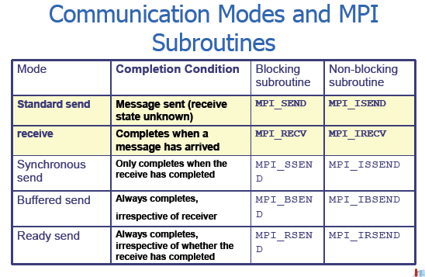

Slide 34
P2P: Blocking Send/Recv
Waits to return until the message has been received by the destination process
This synchronizes the sender with the receiver
Perform a standard mode blocking send and standard mode blocking receive, resp.
The receive can be started before the corresponding send is initiated.
Receive will only return after message data is stored in receive buffer.
The send can be started whether or not the corresponding receive has been posted.

Slide 35
P2P: Blocking Call Semantics
The send will not return until the message data and envelope have been stored such that the sender is free to access and alter the send buffer.
The MPI implementation may buffer your send allowing it to return almost immediately.
If the implementation does not buffer the send, the send will not complete until the matching receive occurs.
This dual-mode behavior should have no effect on well constructed programs, but could be the source of deadlock in poorly constructed programs.

Slide 36
Example
Always succeeds, even if no buffering is done.
if(rank==0)
{
MPI_Send(...);
MPI_Recv(...);
}
else if(rank==1)
{
MPI_Recv(...);
MPI_Send(...);
}

Slide 37
Example
Will always deadlock, no matter the buffering mode.
if(rank==0)
{
MPI_Recv(...);
MPI_Send(...);
}
else if(rank==1)
{
MPI_Recv(...);
MPI_Send(...);
}

Slide 38
Example
Only succeeds if sufficient buffering is present -- strictly unsafe!
if(rank==0)
{
MPI_Send(...);
MPI_Recv(...);
}
else if(rank==1)
{
MPI_Send(...);
MPI_Recv(...);
}

Slide 39
Standard Send-Recv:
Order of send from source process (Send-Send) to receive at target process (Recv-Recv) is maintained.
Order of receive at target process (Recv-Recv) is NOT in order of send (Send-Send).
Order at Process 0 (Send-Recv) and at Process 1 (Recv-Send) maintained.
Order at Process 0 (Send-Recv) and at Process 1 (Send-Recv).
Order at Process 0 (Recv-Send) and at Process 1 (Recv-Send).
NO DEADLOCK.
NO DEADLOCK.
NO DEADLOCK.
NO DEADLOCK.
DEADLOCK OCCURED

Slide 40
Avoiding Deadlocks
Consider:
int a[10], b[10], myrank;
MPI_Status status;
...
MPI_Comm_rank(MPI_COMM_WORLD, &myrank);
if (myrank == 0) {
MPI_Send(a, 10, MPI_INT, 1, 1, MPI_COMM_WORLD);
MPI_Send(b, 10, MPI_INT, 1, 2, MPI_COMM_WORLD);
}
else if (myrank == 1) {
MPI_Recv(b, 10, MPI_INT, 0, 2, MPI_COMM_WORLD);
MPI_Recv(a, 10, MPI_INT, 0, 1, MPI_COMM_WORLD);
}
...
If MPI_Send is blocking, there is a deadlock.

Slide 41
Some semantic terms that are used for the description of MPI operations:
Blocking operation
Non-blocking operation
The terms blocking and non-blocking describe the behavior of operations from the local view of the executing process, without taking the effects on other processes into account.
Synchronous and asynchronous communications:

Slide 42
Buffering in MPI
Implementation may buffer on sending process, receiving process, both, or none.
In practice, tend to buffer "small" messages on receiving process.
MPI has a buffered send-mode:
MPI_Buffer_attach
MPI_Buffer_detach
MPI_Bsend

Slide 43
Avoiding Deadlocks
Using non-blocking operations remove most deadlocks. Consider:
int a[10], b[10], myrank;
MPI_Status status;
...
MPI_Comm_rank(MPI_COMM_WORLD, &myrank);
if (myrank == 0) {
MPI_Send(a, 10, MPI_INT, 1, 1, MPI_COMM_WORLD);
MPI_Send(b, 10, MPI_INT, 1, 2, MPI_COMM_WORLD);
}
else if (myrank == 1) {
MPI_Recv(b, 10, MPI_INT, 0, 2, &status, MPI_COMM_WORLD); MPI_Recv(a, 10, MPI_INT, 0, 1, &status, MPI_COMM_WORLD);
}
...
Replacing either the send or the receive operations with non-blocking counterparts fixes this deadlock.

Slide 44
Collective Communication and Computation Operations
MPI provides an extensive set of functions for performing common collective communication operations.
Each of these operations is defined over a group corresponding to the communicator.
All processors in a communicator must call these operations.

Slide 45
MPI: Collective Communications
Collective communications transmit (and possibly operate on) data among all processes in a given communications group.
Barrier (synchronization), global communications, global reduction operations.

Slide 46
MPI_Barrier (barrier synchronization operation )
int MPI_Barrier(MPI_Comm comm)
blocks the caller until all group members have called it.
syncs all processes in a group to some known point.

Slide 47
MPI_Barrier (barrier synchronization operation )
Stop processes until all processes within a
communicator reach the barrier.
Almost never required in a parallel program
Occasionally useful in measuring performance and load balancing.
int MPI_Barrier(MPI_Comm comm)

Slide 48
MPI: Global Communications
only come in blocking mode calls .
no tag provided, messages are matched by order of execution within the group.
intercommunicators are not allowed.
you cannot match these calls with P2P receives.

Slide 49
Collective Message Passing w/MPI
MPI_Bcast() Broadcast from root to all other processes
MPI_Reduce() Combine values on all processes to single val
MPI_Scatter() Scatters buffer in parts to group of processes
MPI_Gather() Gather values for group of processes
MPI_Alltoall() Sends data from all processes to all processes
MPI_Allgather()
MPI_Allreduce()
MPI_Reduce_Scatter() Broadcast from root to all other processes

Slide 50
Broadcast
MPI: Broadcast (One-to-all)
int MPI_Bcast(void *buffer, int count, MPI_Datatype datatype, int root, MPI_Comm comm);
One process (root) sends data to all the other processes in the same communicator
Must be called by all the processes with the same arguments

Slide 51
MPI: Reduction Operations
Perform global reduce operations across all members of a group.
Many predefined operations come with MPI.
Ability to define your own operations.

Slide 52
Reduction
MPI: Reduce (all-to-one reduction operation )
int MPI_Reduce(void *sendbuf, void *recvbuf, int count, MPI_Datatype datatype, MPI_Op op, int root, MPI_Comm comm)
One process (root) collects data to all the other processes in the same communicator, and performs an operation on the data
MPI_SUM, MPI_MIN, MPI_MAX, MPI_PROD, logical AND, OR, XOR, and a few more
returns combined value in the output buffer

Slide 53
Predefined Reduction Operations
Operation Meaning Datatypes
MPI_MAX Maximum C integers and floating point
MPI_MIN Minimum C integers and floating point
MPI_SUM Sum C integers and floating point
MPI_PROD Product C integers and floating point
MPI_LAND Logical AND C integers
MPI_BAND Bit-wise AND C integers and byte
MPI_LOR Logical OR C integers
MPI_BOR Bit-wise OR C integers and byte
MPI_LXOR Logical XOR C integers
MPI_BXOR Bit-wise XOR C integers and byte
MPI_MAXLOC max-min value -location Data-pairs
MPI_MINLOC min-min value-location Data-pairs

Slide 54
Gather
MPI: Gather
int MPI_Gather(void *sendbuf, int sendcnt, MPI_Datatype sendtype, void *recvbuf, int recvcnt, MPI_Datatype recvtype, int root, MPI_Comm comm)
One process (root) collects data to all the other processes in the same communicator (i.e each process in comm (including root itself) sends its sendbuf to root.)
the root process receives the messages in recvbuf in rank order.
Must be called by all the processes with the same arguments

Slide 55
MPI: Scatter
int MPI_Scatter(void *sendbuf, int sendcount, MPI_Datatype sendtype, void *recvbuf, int recvcount, MPI_Datatype recvtype, int root, MPI_Comm comm)
inverse to MPI_Gather.
sendbuf is ignored by all non-root processes.

Slide 56
Gather to All
MPI: Allgather
int MPI_Allgather(void *sendbuf, int sendcnt, MPI_Datatype sendtype, void *recvbuf, int recvcnt, MPI_Datatype recvtype, MPI_Comm comm)
MPI also provides the MPI_Allgather function in which the data are gathered at all the processes.
All the processes collects data to all the other processes in the same communicator.
recvbuf is NOT ignored.
Must be called by all the processes with the same arguments

Slide 57
Reduction to All
MPI: Allreduce
int MPI_Allreduce(void *sendbuf, void *recvbuf, int count, MPI_Datatype datatype, MPI_Op op, MPI_Comm comm)
All the processes collect data to all the other processes in the same communicator, and perform an operation on the data
MPI_SUM, MPI_MIN, MPI_MAX, MPI_PROD, logical AND, OR, XOR, and a few more
MPI_Op_create(): User defined operator
- If the result of the reduction operation is needed by all processes, MPI provides MPI_Allreduce

Slide 58
MPI: Alltoall
int MPI_Alltoall(void *sendbuf, int sendcount, MPI_Datatype sendtype, void *recvbuf, int recvcount, MPI_Datatype recvtype, MPI_Comm comm)
similar to MPI_Allgather except each process sends distinct data to each of the receivers.
the j^{th} block sent from process i is received by process j and placed in the i^{th} block of recvbuf.

Slide 59
Collective Communication Operations
To compute prefix-sums, MPI provides:
int MPI_Scan(void *sendbuf, void *recvbuf, int count, MPI_Datatype datatype, MPI_Op op,
MPI_Comm comm)

Slide 60
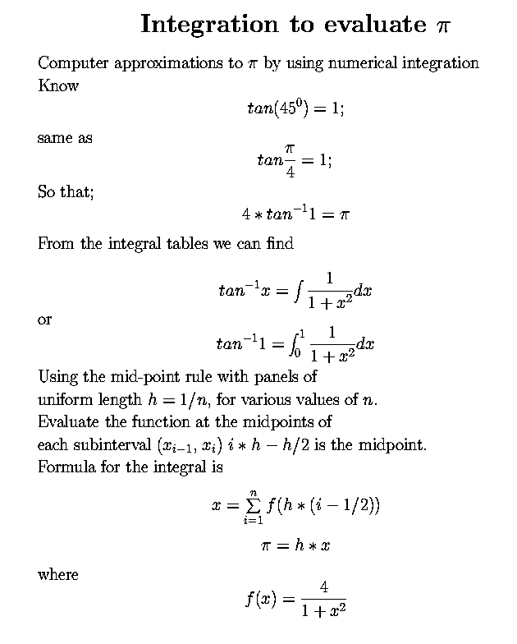
Approximation of Pi Compute π value using p processors.

Slide 61
Example: PI in C -1
#include "mpi.h"
#include <math.h>
int main(int argc, char *argv[])
{ int done = 0, n, myid, numprocs, i, rc; double PI25DT = 3.141592653589793238462643; double mypi, pi, h, sum, x, a; MPI_Init(&argc,&argv); MPI_Comm_size(MPI_COMM_WORLD,&numprocs); MPI_Comm_rank(MPI_COMM_WORLD,&myid); while (!done) { if (myid == 0) { printf("Enter the number of intervals: (0 quits) "); scanf("%d",&n); } MPI_Bcast(&n, 1, MPI_INT, 0, MPI_COMM_WORLD); if (n == 0) break;

Slide 62
Example: PI in C - 2
h = 1.0 / (double) n; sum = 0.0; for (i = myid + 1; i <= n; i += numprocs) { x = h * ((double)i - 0.5); sum += 4.0 / (1.0 + x*x); } mypi = h * sum; MPI_Reduce(&mypi, &pi, 1, MPI_DOUBLE, MPI_SUM, 0, MPI_COMM_WORLD); if (myid == 0) printf("pi is approximately %.16f, Error is %.16f\n", pi, fabs(pi - PI25DT)); } MPI_Finalize();
return 0;
}

Slide 63
MPI: Scan
int MPI_Scan(void *sendbuf, void *recvbuf, int count, MPI_Datatype datatype, MPI_Op op,
MPI_Comm comm)

Slide 64
TIME CALCULATION:
The elapsed (wall-clock) time between two points in an MPI program can be computed using MPI_Wtime
MPI_Wtime
Returns an elapsed time on the calling processor
double MPI_Wtime( void );
Return value
Time in seconds.
Remarks
MPI_WTIME returns a floating-point number of seconds.
The times returned are local to the node that called them.

Slide 65
#include "mpi.h" #include <windows.h> #include <stdio.h> #include<conio.h>
int main( int argc, char *argv[] ) { double t1, t2; MPI_Init( 0, 0 );
t1 = MPI_Wtime();
Sleep(1000);
t2 = MPI_Wtime();
printf("MPI_Wtime measured a 1 second sleep to be:
%1.2f\n", t2-t1);
fflush(stdout);
getch(); MPI_Finalize( ); return 0; }

Slide 66
Handling MPI Errors
The error handler is called every time an MPI error is detected within the communicator.
There is a predefined error handler, which is called MPI_ERRORS_RETURN.
error handler can be used by calling function MPI_Errhandler_set.
MPI_Errhandler_set(MPI_COMM_WORLD, MPI_ERRORS_RETURN);
Once you've done this in your MPI code, the program will no longer abort on having detected an MPI error, instead the error will be returned and you will have to handle it.

Slide 67
Handling MPI Errors (Contd..)
The returned error code is implementation specific.
The only error code that MPI standard itself defines is MPI_SUCCESS, i.e., no error.
MPI standard defines so called error classes.
Every error code, must belong to some error class, and the error class for a given error code can be obtained by calling function MPI_Error_class.
Error classes can be converted to comprehensible error messages by calling MPI_Error_string.
Meaning of an error code can be extracted by calling function MPI_Error_string.

Slide 68
#include "mpi.h"
#include <stdio.h>
#include<conio.h>
void ErrorHadler(int error_code)
{
}
int main(int argc,char *argv[])
{
int C=3;
int numtasks, rank, len, error_code;
error_code = MPI_Init(&argc,&argv);
MPI_Errhandler_set(MPI_COMM_WORLD, MPI_ERRORS_RETURN);
MPI_Comm_rank(MPI_COMM_WORLD,&rank);
error_code = MPI_Comm_size(C, &numtasks);
ErrorHadler(error_code);
printf ("Number of tasks= %d My rank= %d \n", numtasks,rank);
MPI_Finalize();
}

Slide 69
#include "mpi.h"
#include <stdio.h>
#include<conio.h>
void ErrorHadler(int error_code)
{
if (error_code != MPI_SUCCESS)
{
char error_string[BUFSIZ];
int length_of_error_string, error_class;
MPI_Error_class(error_code, &error_class);
MPI_Error_string(error_class, error_string, &length_of_error_string);
fprintf(stderr, " %s %d\n", error_string,length_of_error_string);
MPI_Error_string(error_code, error_string, &length_of_error_string);
fprintf(stderr, "HELLO_ERRORCODE %s\n", error_string);
}
}

Slide 70
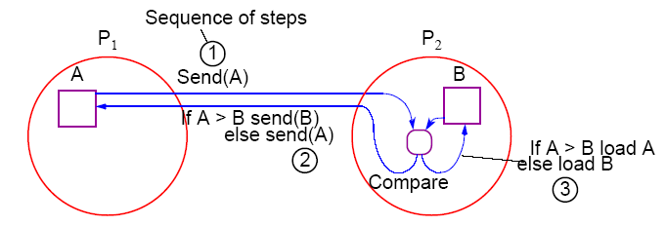
Message-Passing Compare and Exchange
Version 1
P1 sends A to P2, which compares A and B and sends back B to P1 if A is larger than B (otherwise it sends back A to P1):

Slide 71
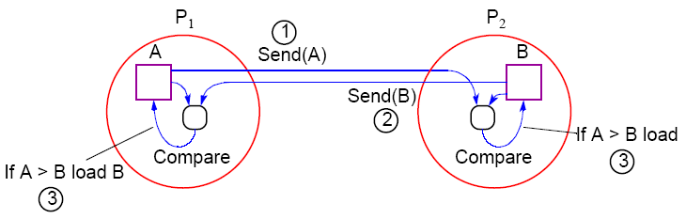
Alternative Message Passing Method
Version 2
For P1 to send A to P2 and P2 to send B to P1. Then both processes perform compare operations. P1 keeps the larger of A and B and P2 keeps the smaller of A and B:

Slide 72
ODD-EVEN TRANSPOSITION SORTING:-
This is designed for processor array model in which the processing elements are organized in one-dimensional mesh.
Let A=(a₀,a₁,….,a_{n-1}) is the set of n elements to be sorted.

Slide 73
Each PE (totally n PEs) contain two local variables :a and t ; a unique element of array A and a variable t containing a value retrieved from a neighboring PE.
Algorithm performs (n / 2) iterations and each iteration will have two phases:

Slide 74
1st Phase: called odd-even exchange, value of a in every odd numbered processor (except processor n-1) is compared with the value of a stored in successor processor.
Values are exchanged if lower numbered processor contains the larger value.

Slide 75
2nd Phase: called even-odd exchange, value of a in every even numbered processor is compared with the value of a stored in successor processor.
Values are exchanged if lower numbered processor contains the larger value.
After n/2 iterations the values are observed to be sorted.

Slide 76
Odd-even transposition sort(one dimensional mesh processor array):
parameter n
global i
local a,t
{
for(i=1; i ≤ n/2; i++)
{ for all P_{j} , where 0 ≤ j ≤ n-1 do
{
if j <(n-1) and odd(j) then
{
t←successor(a);
successor(a)←max(a,t);
a ←min(a,t);
}
if even(j) then
{
t←successor(a);
successor(a)←max(a,t);
a ←min(a,t);
}
}
} }

Slide 77
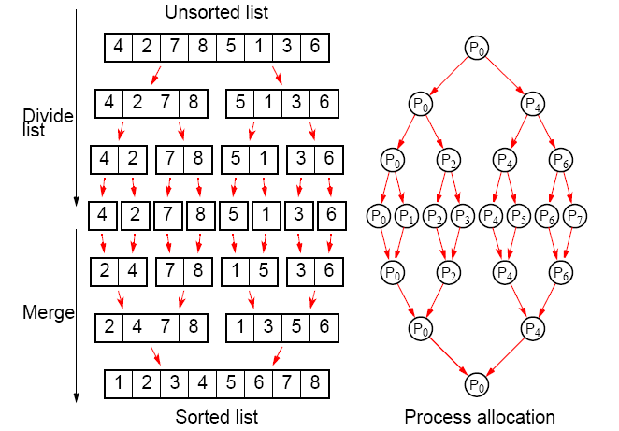
Parallelizing Mergesort
Using tree allocation of processes

Slide 78
Matrix Multiplication in MPI

